Slide 1


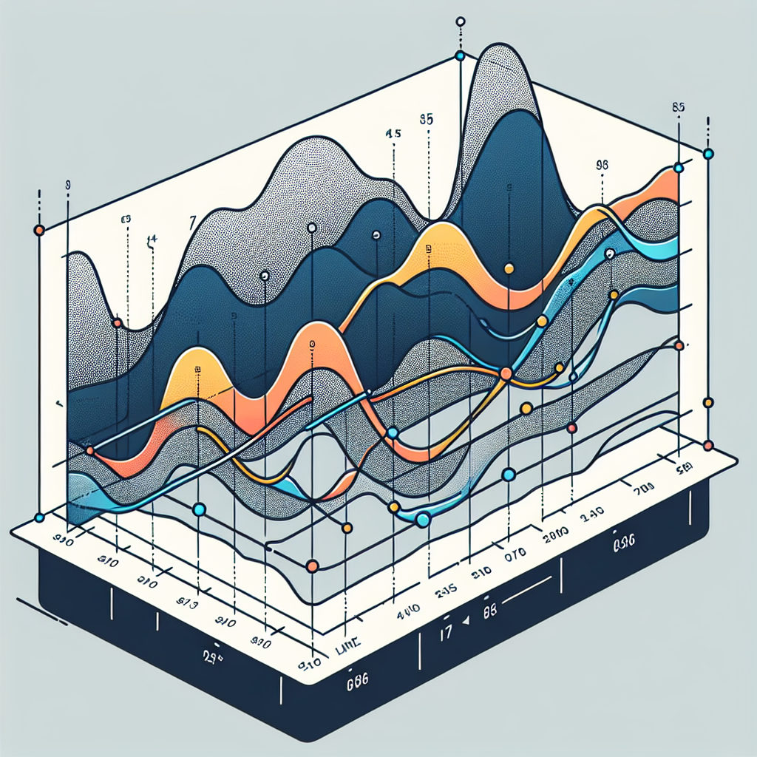
Governance and KPI Dashboard
Governance model: Steering committee: CEO (chair), CFO, COO, VP Sustainability, VP Supply Chain — meets monthly Program management office: Head of Decarbonization + site PMs — weekly cadence Workstreams: - Efficiency - Energy procurement - Electrification - Supplier/Scope 3 - Data & reporting Assurance: Annual third-party verification (limited to reasonable by 2028)
Total emissions (ktCO2e, Scopes 1–3): Baseline: 150, Target 2030: 0, Milestone 2025: 120, Frequency: Quarterly
Scopes 1+2 market-based (ktCO2e): Baseline: 45, Target 2030: 0, Milestone 2025: 25, Frequency: Monthly
Renewable electricity share (%): Baseline: 22, Target 2030: 100, Milestone 2025: 45, Frequency: Monthly
Energy intensity (kWh per unit output): Baseline: 12, Target 2030: 8, Milestone 2025: 10, Frequency: Quarterly
Supplier coverage (% spend with SBTi targets): Baseline: 15, Target 2030: 80, Milestone 2025: 40, Frequency: Quarterly
Project schedule adherence (%): Baseline: None, Target 2030: 95, Milestone 2025: 90, Frequency: Monthly

